Slide 1





DYNAMIC DEPTH WARPING

Slide 2
PROJECT NAME MLSequence????
TEAM NAME Dynamic Depth Warping
Intro – team (pure blues and pure pinks), task/challenge, data used
Software demo if poss
description of techniques used for ML
front end
results
Future applications and further work
Commercial value – removing interpretative bias
uncertainty
identifying missed struct/strat info– highlight new potential

Slide 3
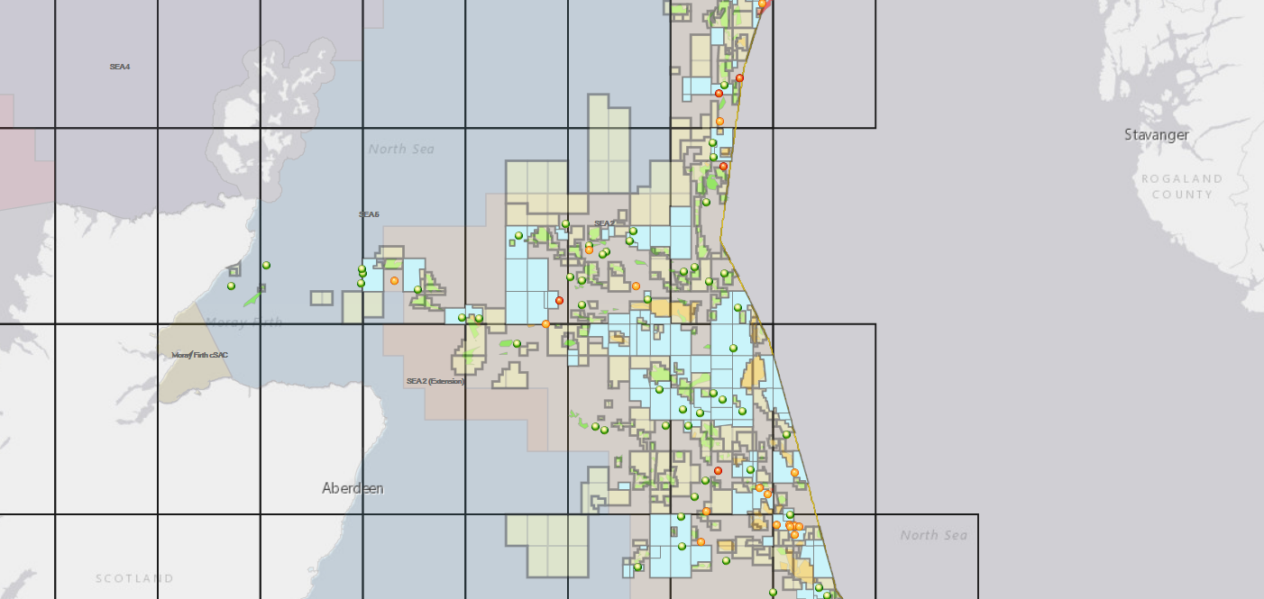
Data used

Slide 4
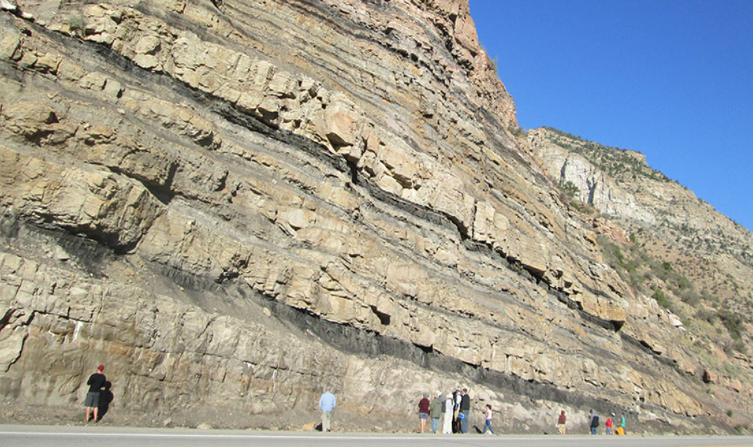
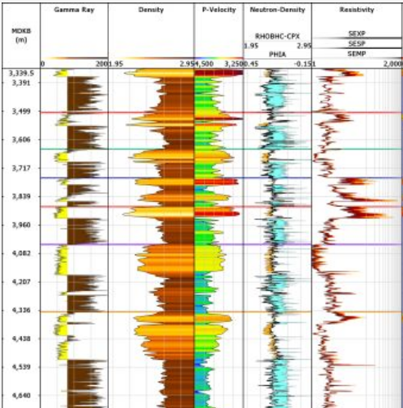
The problem….

Slide 5
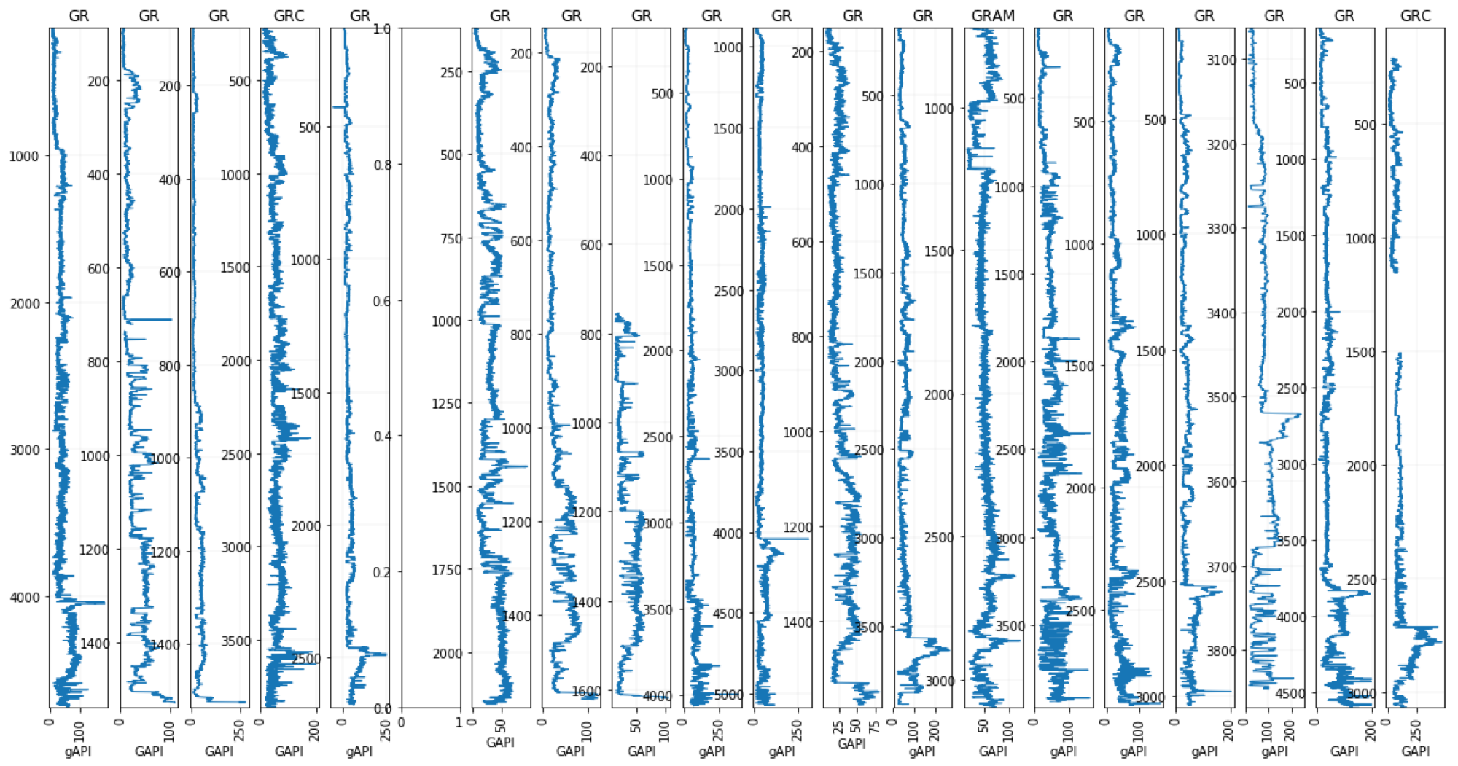
Data loading & QC
20 wells (GR only), zone of interest selected

Slide 6
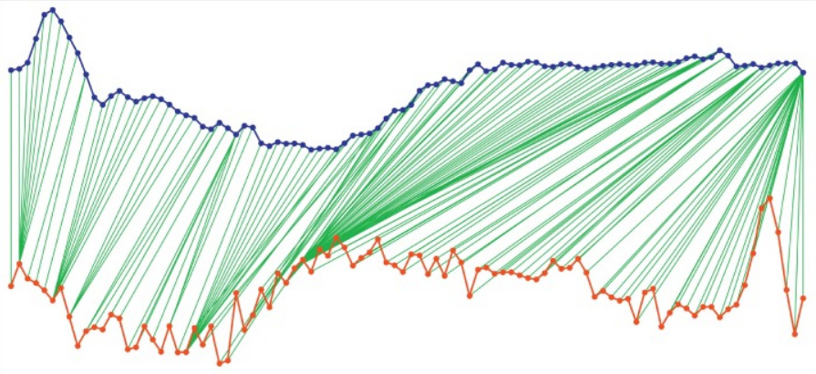
Dynamic Time Warping

Slide 7
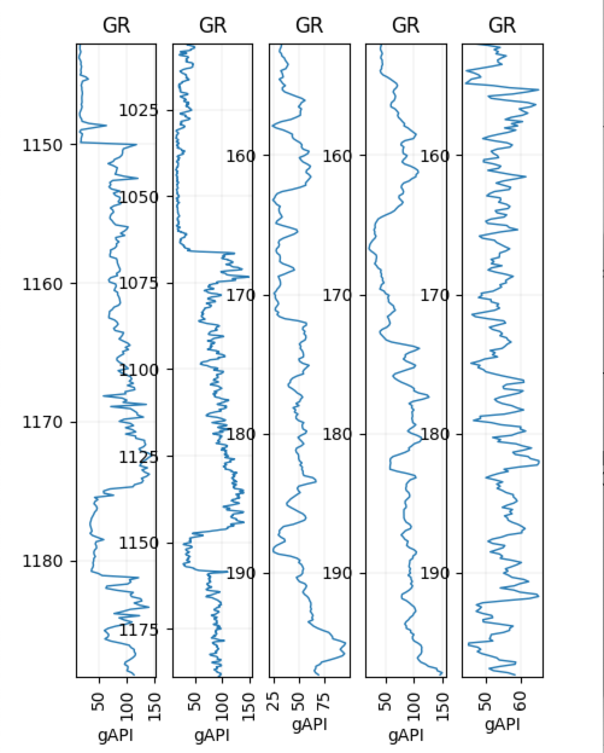
Example of pattern match
Base curve for matching

Slide 8
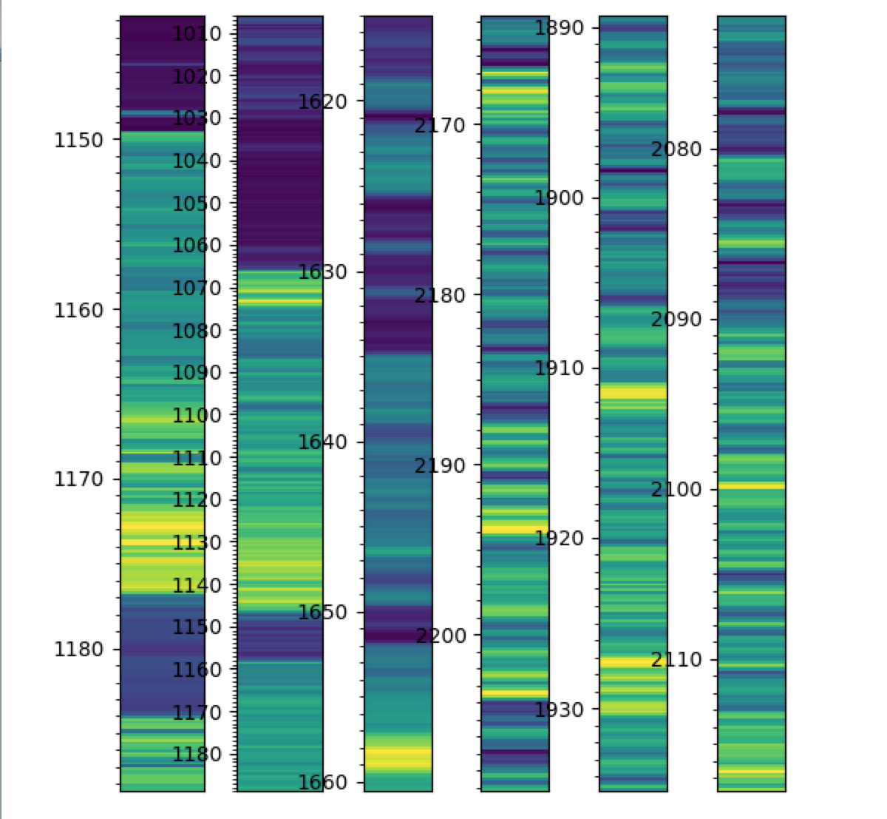
Colour coding to show highs and lows in values

Slide 9
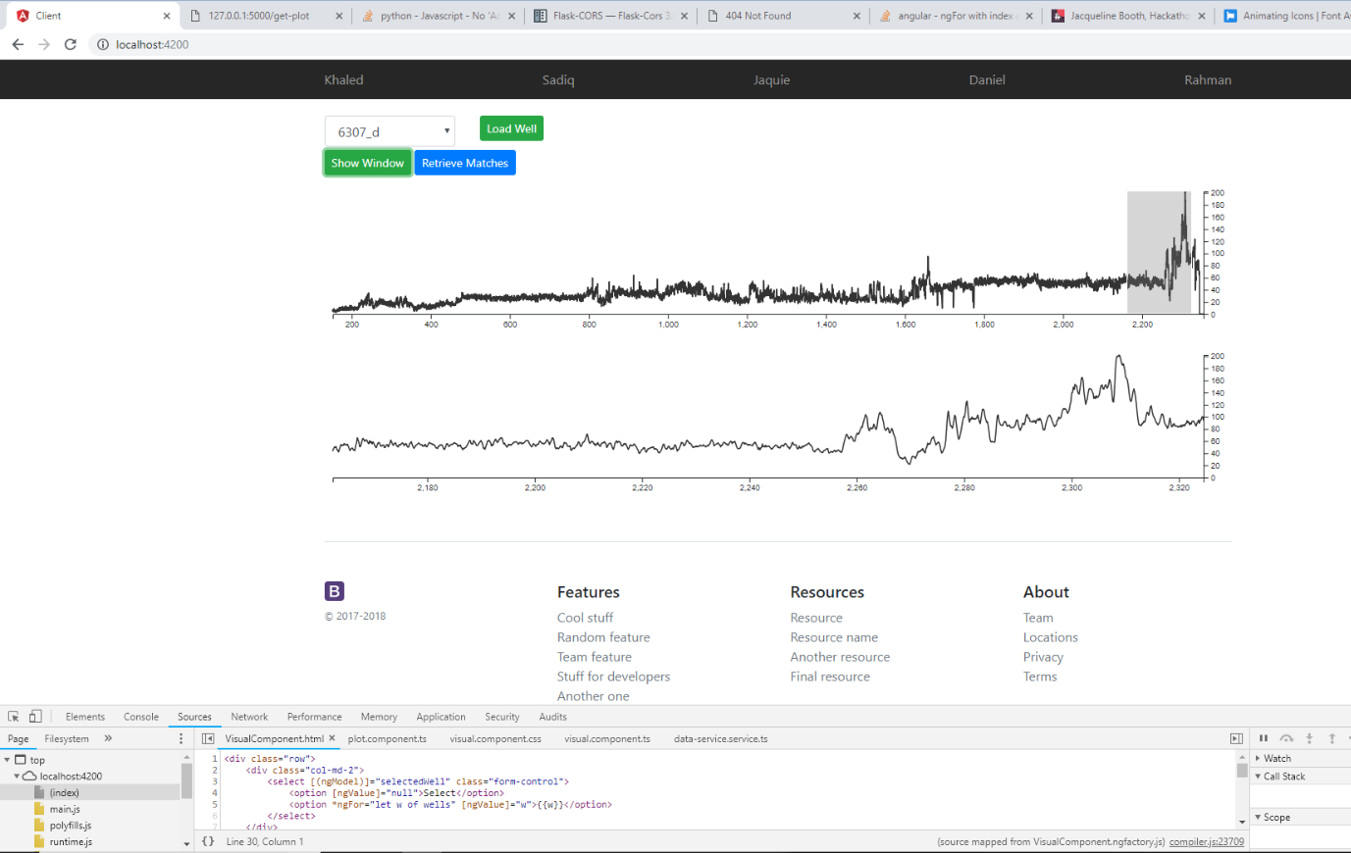
Front end

Slide 10
Further developments and future work
Integration of front end with the dynamic depth warping system
Indicators for quality of correlation
Extend test to larger datasets
Ability to add additional log curves to the analysis (NPHI-RHOB-RES)

Slide 11
Commercial Value
Removal of interpretative bias
Quantify uncertainty
Identifying missed structural and/or stratigraphic information – highlight new potential

